Slide 1
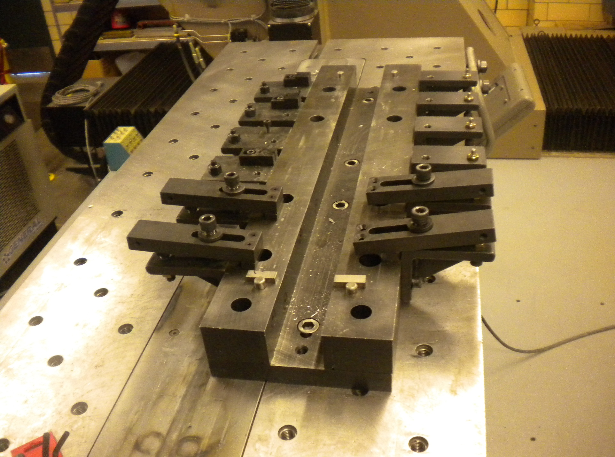
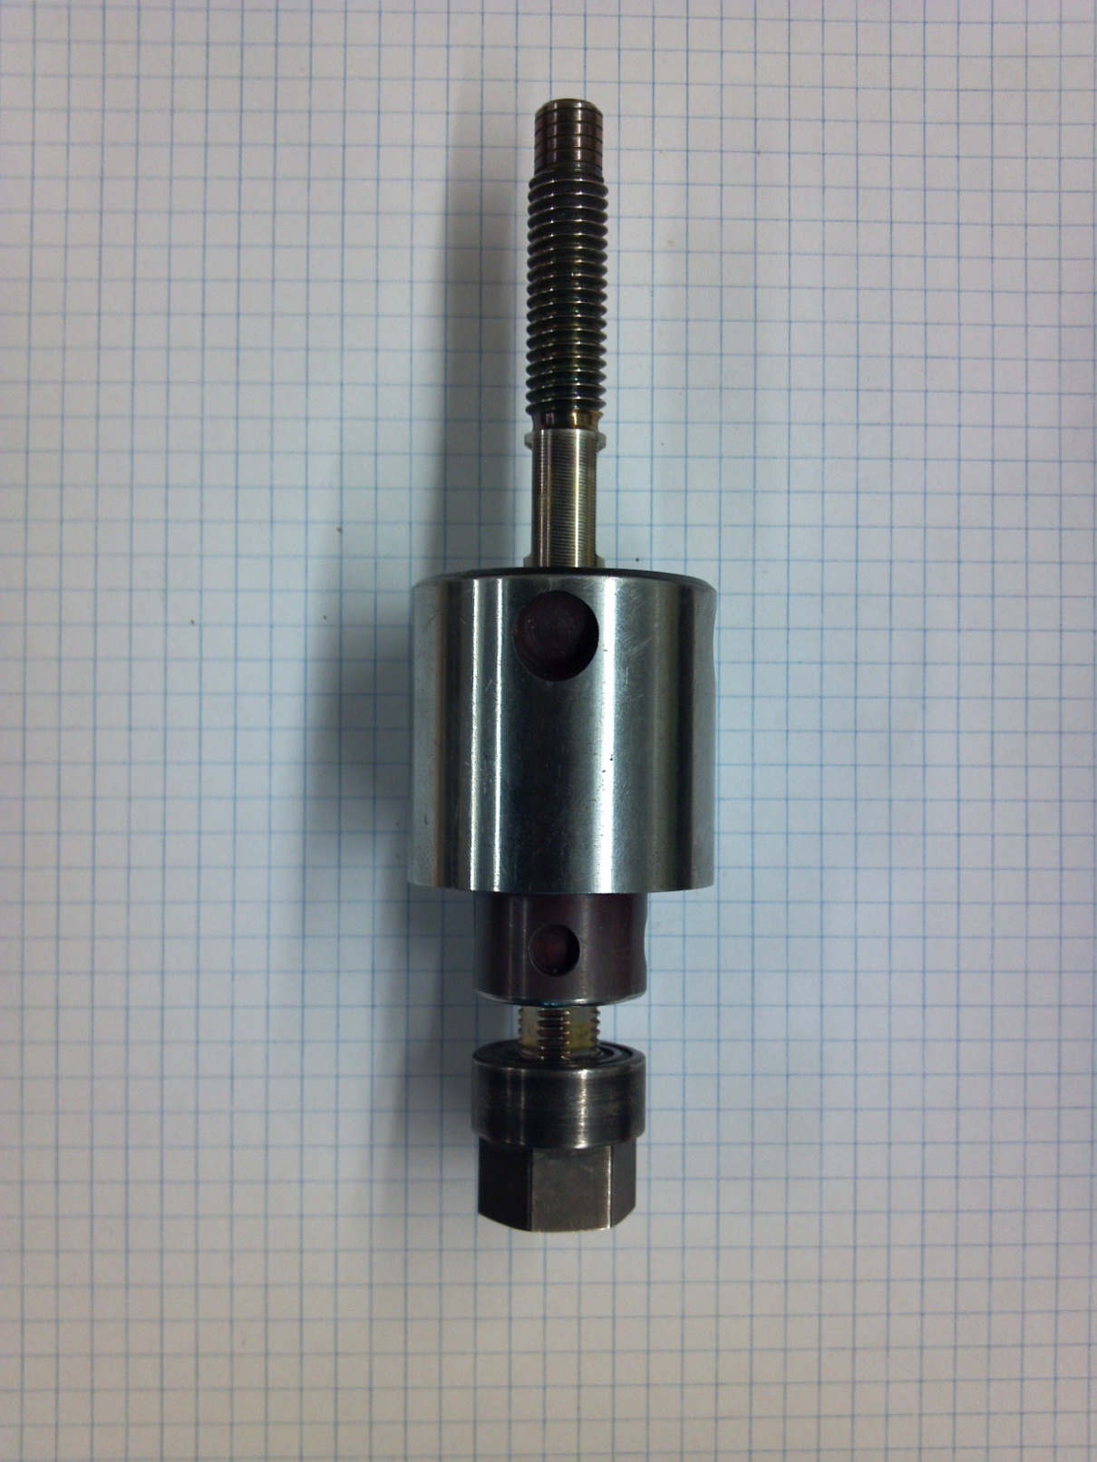
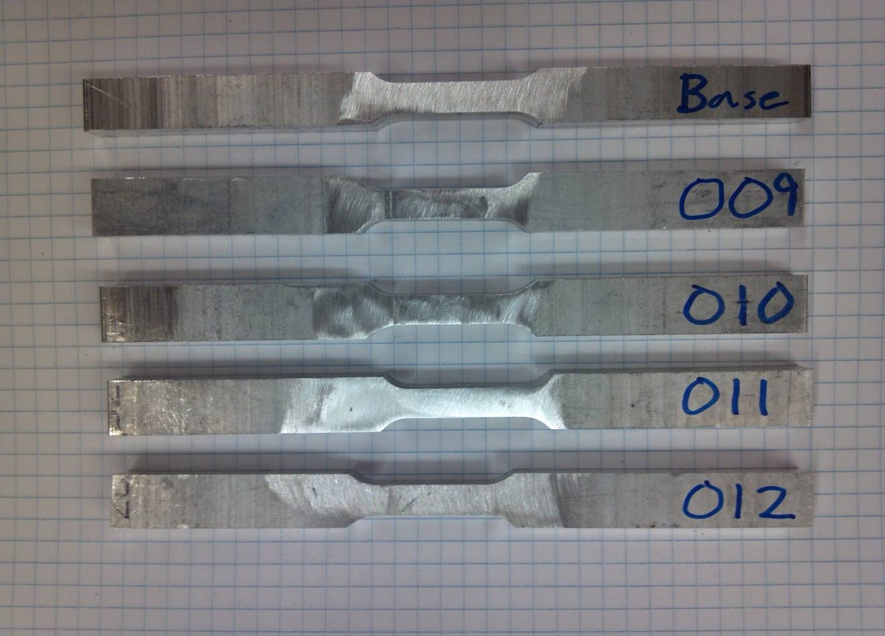
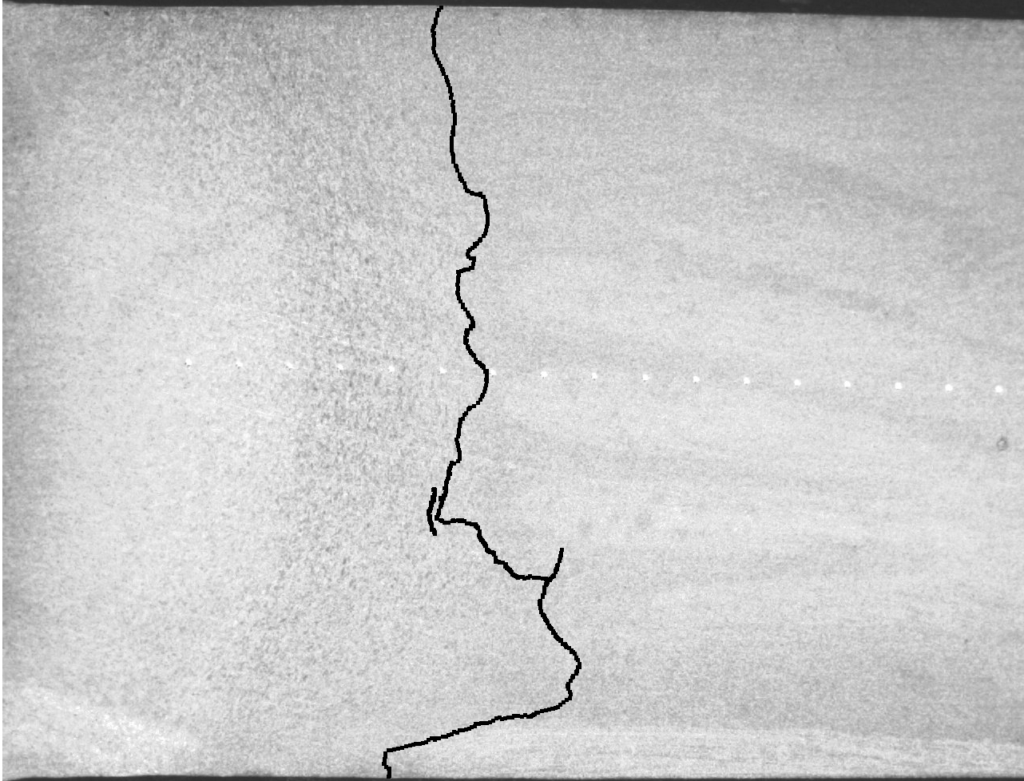
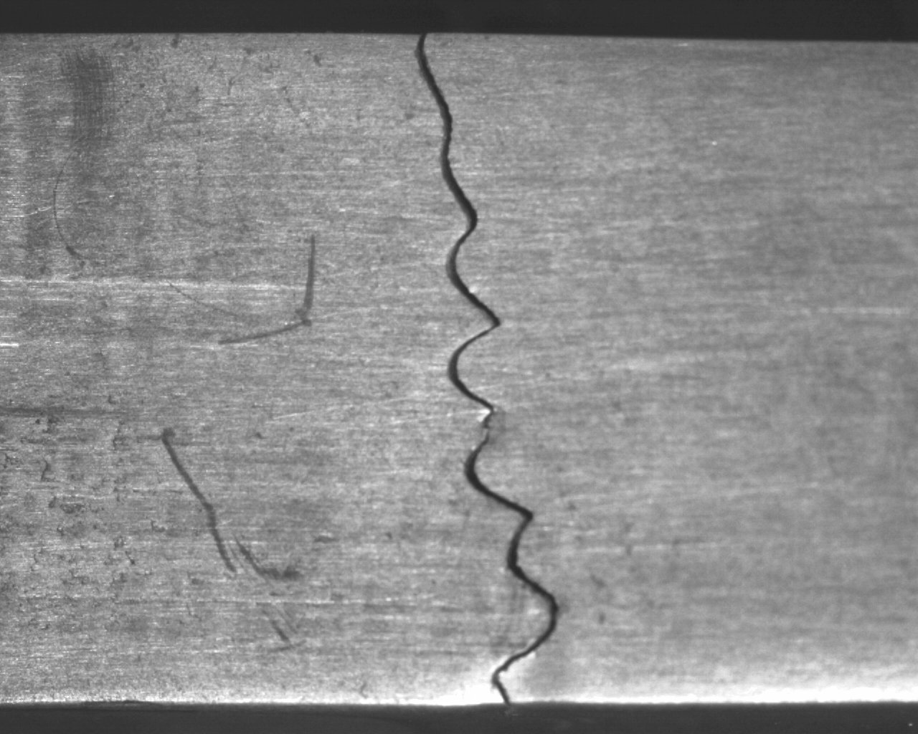
The Impact of the “Lazy S” Defect on the Mechanical Properties of a Self-Reacting Friction Stir Weld on Al 2024-T4
Research Undergraduate: Joshua Walters
Advisor: Dr. Michael West
Objectives
Results
Test the mechanical properties of a self-reacting friction stir weld that has signs of the “Lazy S” defect
Objective 1 – Experimentally establish weld parameters that are favorable for the formation of the “Lazy S” defect
Objective 2 – Test the mechanical properties of the welds to determine if the “Lazy S” defect has any impact on them
Metallographic analysis revealed an observable “Lazy S” formation in all the butt welds performed in the experiment. After mechanical testing was performed, it was discovered that while the micro-hardness was relatively unaffected, the tensile properties of the welds were severely compromised. Welds that had greater signs of the “Lazy S” formation had a considerably lower peak stress during tensile testing.
Figure 2: Clamping mechanism for the self-reacting tool
Figure 3: The “Lazy S” defect near the root of a weld
Procedures
Conclusions
Objective 1 Procedures
Make a series of bead-on-plate style welds using varying weld parameters (Spindle Speed, Travel Speed)
Analyze the macro-structure of each weld to determine whether the weld is defective
Objective 2 Procedures
Perform a series of butt joint welds using the parameters established in objective 1
Test the welds to determine whether the mechanical properties are affected by the “Lazy S” defect
Based on the discoveries of the experimentation, the “Lazy S” defect has a significant impact on the mechanical properties of a self-reacting weld made with 2024-T4 Aluminum. The research found that while micro-hardness measurements showed minute differences in hardness, the tensile properties of the welds were substantially compromised by the presence of the “Lazy S” defect. The defect contributed to the initiation of cracks during tensile testing, and, in the case of welds 011 and 012, made up the entire fracture surface.
Figure 5: Tensile Samples before testing
Table 1 Tensile Test Data
Sample | Average Peak Stress (Ksi) | Peak Stress (% of Base Metal) | Average Elongation (%)
Base Metal | 71.2 | n/a | 20.2
009 | 47.4 | 66.6 | 4.4
010 | 49.6 | 69.7 | 3.7
011 | 31.5 | 44.2 | 2.0
012 | 26.0 | 36.5 | 0.2
Figure 4
Top: Highlighted “Lazy S” defect
Bottom: Tensile Sample Crack
Figure 1 Picture of a self-reacting FSW tool
Impact
Future Work
Self-reacting tools are still relatively new in the world of friction stir welding, and are still not entirely accepted as an effective means of joining materials. The research in this project is a step toward making self-reacting tools more acceptable in an industrial setting. The use of self-reacting tools could make many obstacles, such as welding intricate or closed shapes, much more reasonable. This could potentially establish FSW in many significant industries, such as the pipe-fitting or petroleum industries.
There are many unknown factors that could be further explored regarding the “Lazy S” defect. Its formation in other types of alloys is a major area that could be investigated, as wells as investigating preventative measures to minimize the chance of its formation.
Acknowledgements:
Thanks to the National Science Foundation grant # 0852057
Drs. Michael West, Alfred Boysen, and Bharat Jasthi, and to the SDSM&T AMP Center.

